Slide 1


Veteran
Services
careersourceokaloosawalton.com
409 Racetrack Road
Fort Walton Beach
850.833.7587
761 North 20th Street DeFuniak Springs 850. 892.1240
ext. 5167

Slide 2

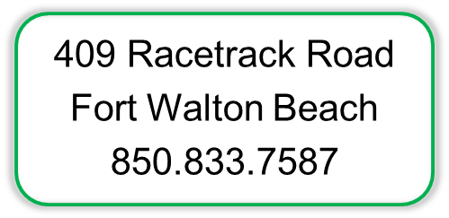
CareerSourceOkaloosaWalton.com
761 North 20th Street
DeFuniak Springs
850.892.1240
ext. 5167

Slide 3
Labor
Market
Information
Labor Market Information (LMI) could be described as the body of knowledge that reports information on the number of people employed or unemployed, unemployment rates, average wages, population, income, occupational projections and other economic variables. The LMI Department, through federal grants with the Bureau of Labor Statistics and the Employment and Training Administration, operates statistical programs to capture and report economic information.

Slide 4
LMI… You
Is this a growing career field?
Where are the jobs?
What does it pay?
Do I need training or certifications?

Slide 5
LMI…Them
What is the local area profile?
Where is the labor force?
What should we pay?
Is the Training capacity in place?
TAP Survey for Economic Development Council

Slide 6
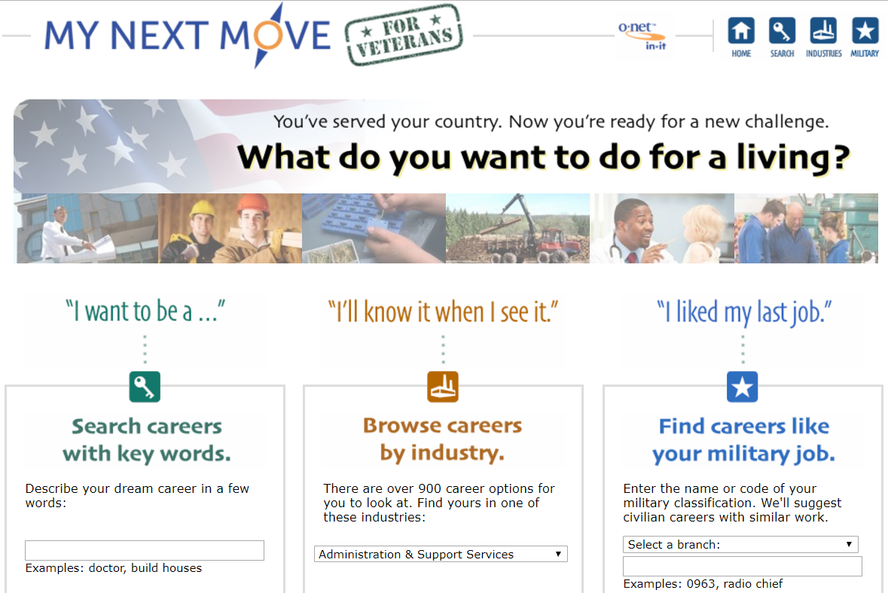

Slide 8
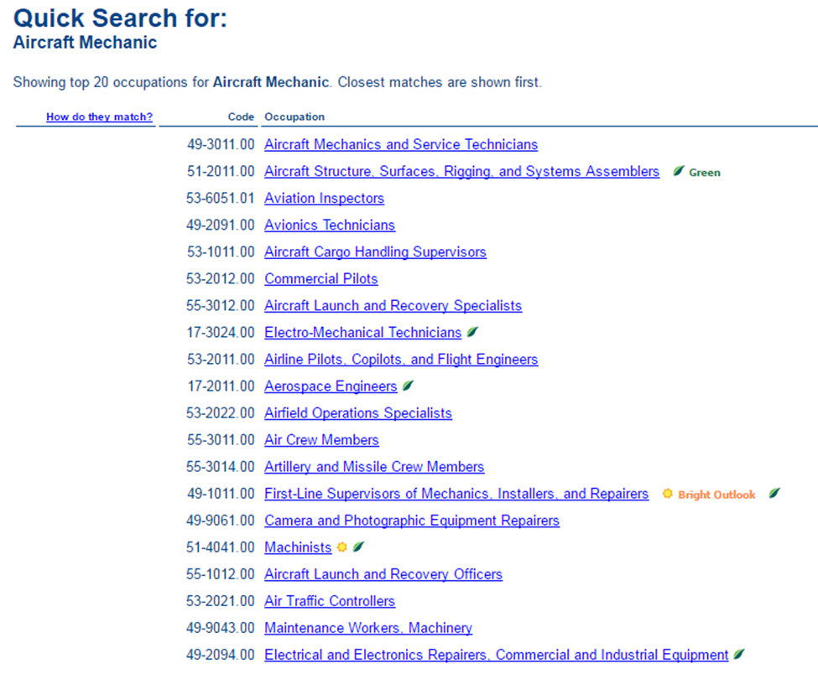

Slide 10
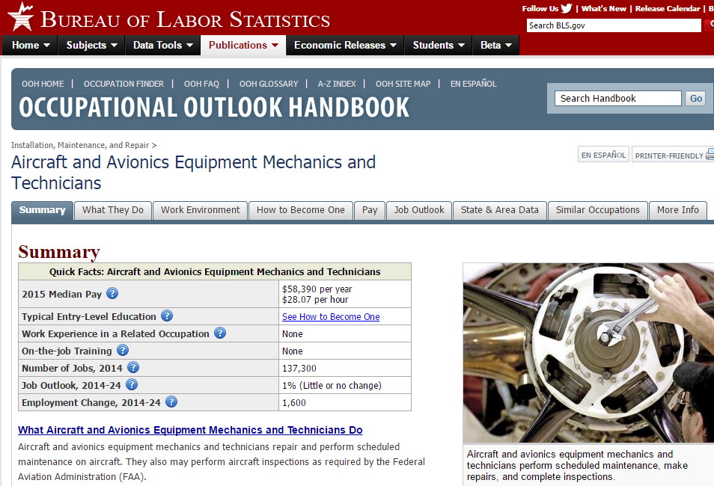

Slide 11


Slide 12
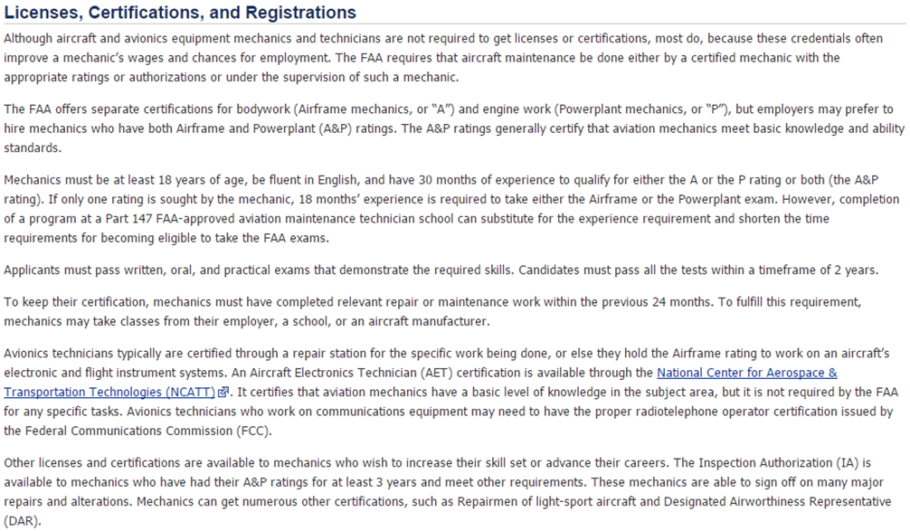

Slide 13
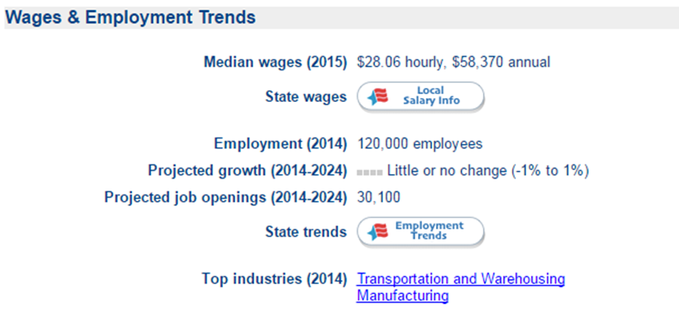

Slide 14
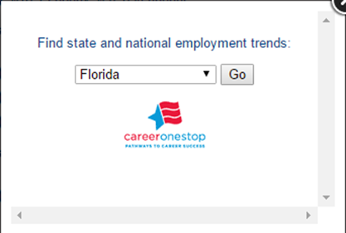
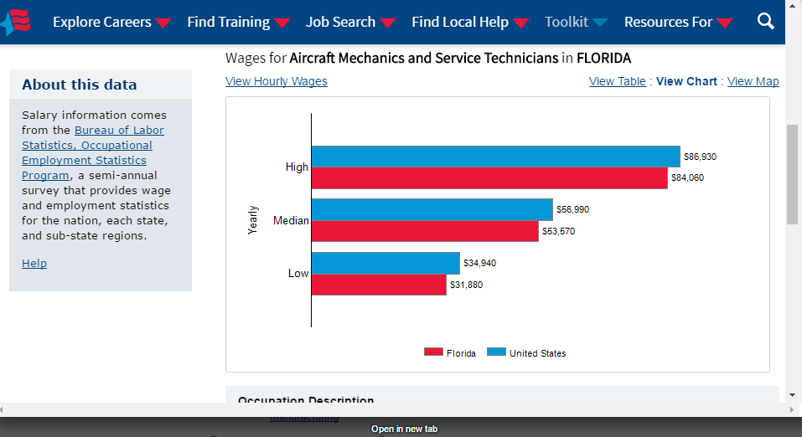

Slide 15
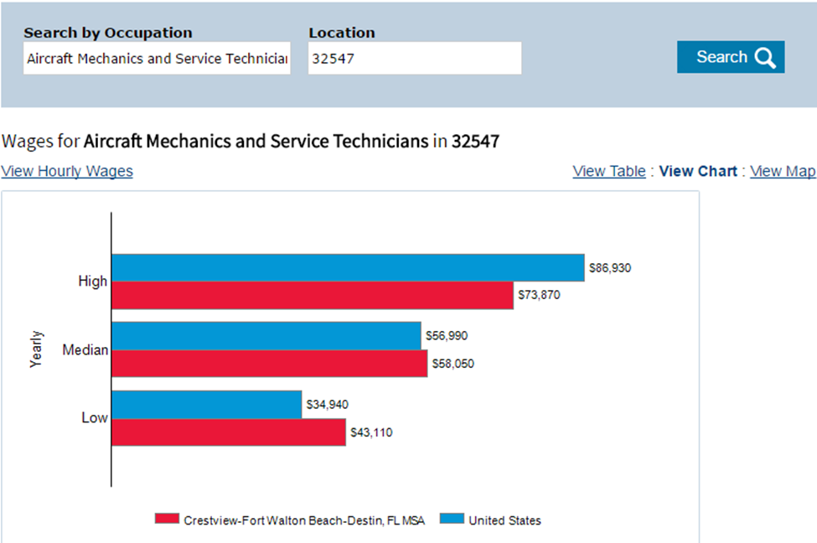

Slide 16


Slide 17

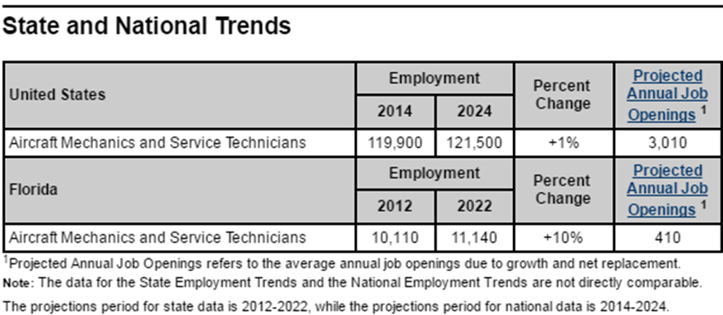

Slide 18
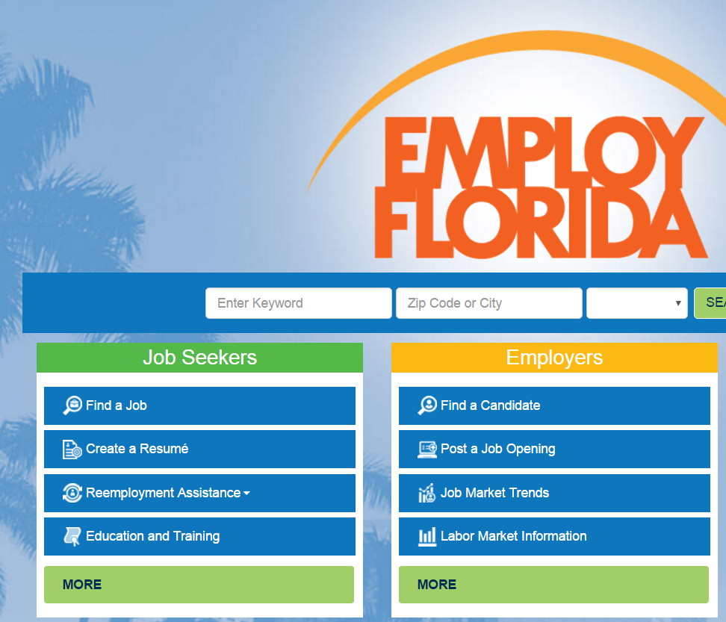
Staying ? Considering? EmployFlorida.com
careeronestop.org – National Directory

Slide 19
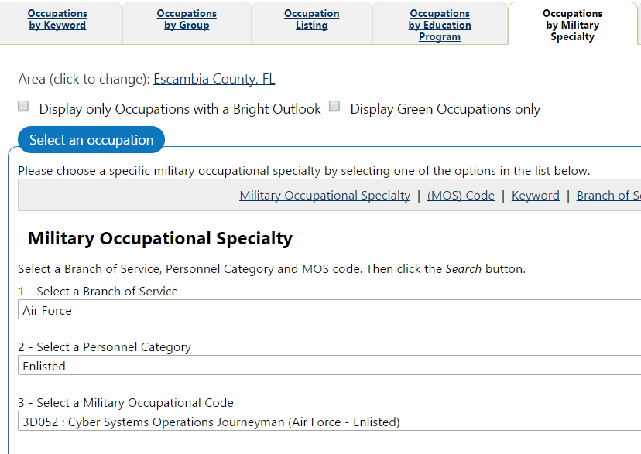
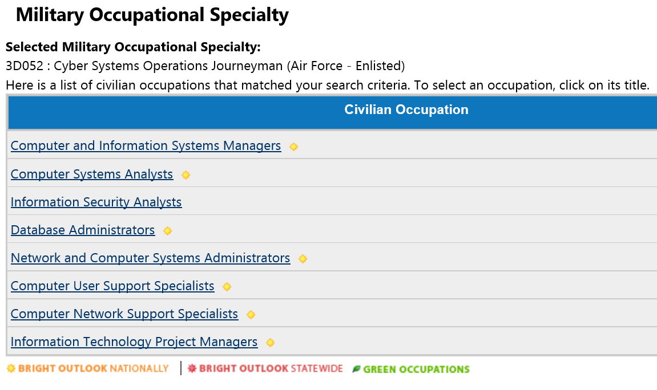
EmployFlorida.com
Servicelocator.org – National Directory

Slide 20
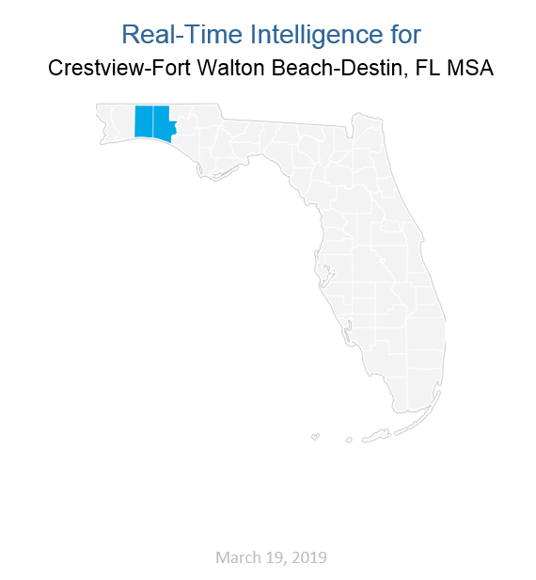
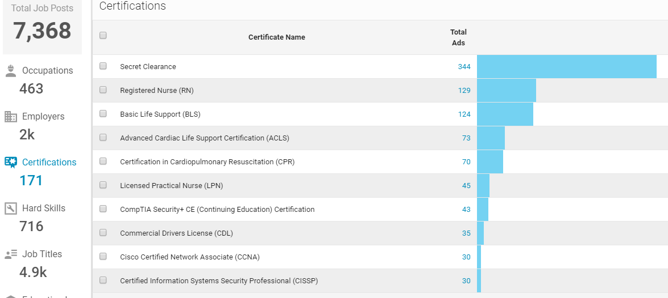
Real Time Intelligence
Notes:
Added by request of Ms. Valerie

Slide 21

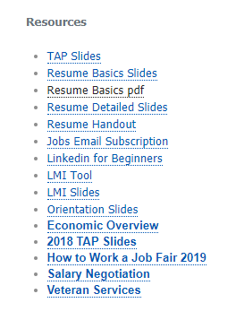
CareerSourceOkaloosaWalton.com
Notes:
Added by request of Ms. Valerie

